Slide 1
AER 1216 – Fundamentals of UAVs
Lecture 11 - Quadrotor Dynamics and Control I
Karime Pereida, Ph.D.
Prof. Angela Schoellig

Slide 2
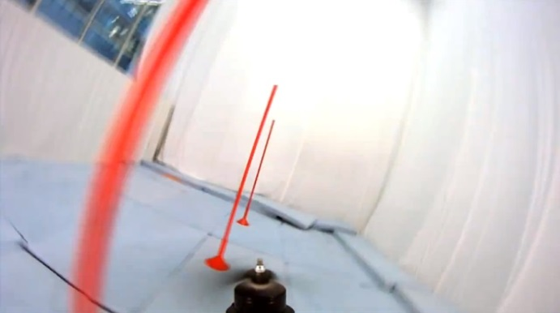
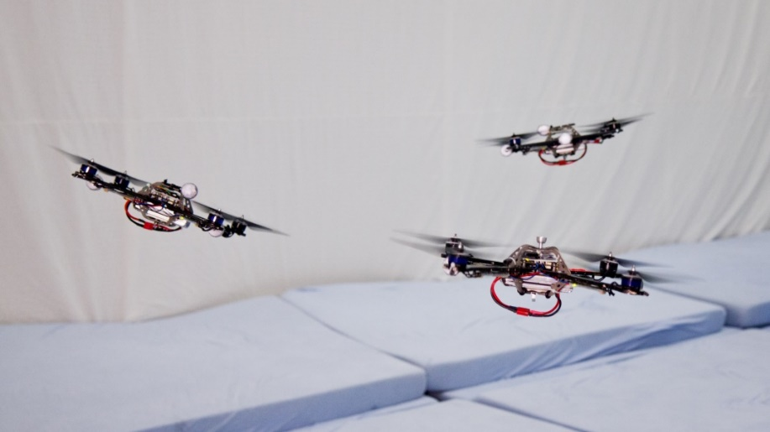
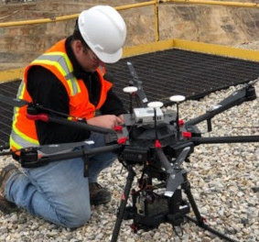
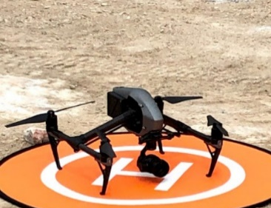
Welcome!
High-speed maneuver learning
Prof. Angela P. Schoellig
Head of the Dynamic Systems Lab at UTIAS
Associate Director of the Centre for Aerial Robotics Research & Education (CARRE)
email: schoellig@utias.utoronto.ca
web: www.dynsyslab.org
office: #187
Collision-free, multi-vehicle flight
Mining applications

Slide 3
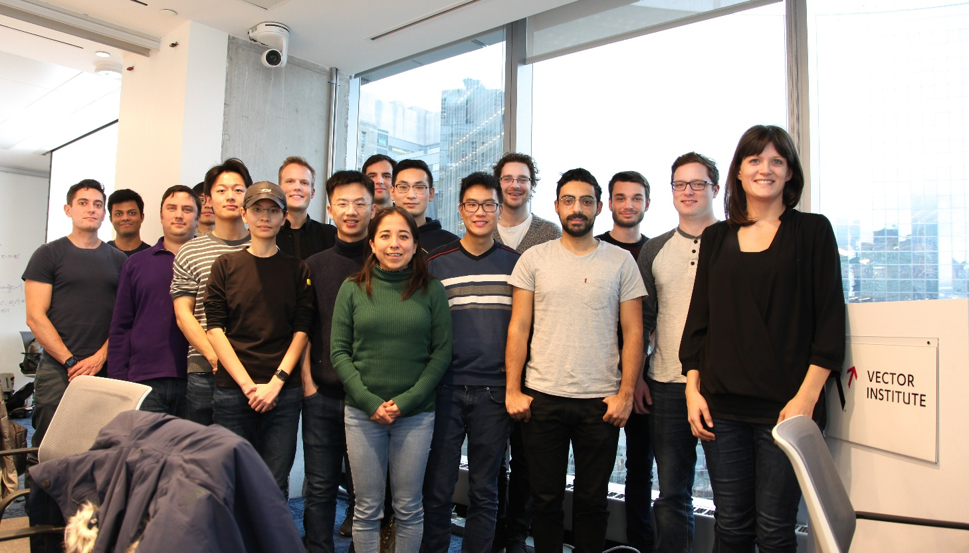




Dynsyslab Research Team
Research topics: motion planning, control and learning for single and multiple autonomous systems/robots
2 postdocs, 11 PhD students, 7 MASc students
Student office #191
Lab room #195
twitter.com/dynsyslab
facebook.com/DynamicSystemsLab
linkedin.com/company/dynsyslab
YT Channel: Dynamic Systems Lab

Slide 4
Context
Part of Centre for Aerial Robotics Research and Education (CARRE)’s training program
AER1216: Fundamentals of UAVs
Fundamental principles related to UAV design
How to design/build a UAV that satisfies given design specifications?
Being able to build a remote controlled UAV
AER1217: Development of UAS
Important aspects related to UAV autonomy (control, planning, vision)
How to design/build an UAV that autonomously achieves a given task?
Being able to build a fully autonomous UAV

Slide 5
Quadrotor Dynamics and Control Lectures
Lecture 1 | Lecture 2 | Lecture 3
Introduction to quadrotor control Controlling the up-down motion of the quadrotor | Controlling the quadrotor in 2D (y-z plane) Introduction to nonlinear controllers | Controlling the quadrotor in 3D Setting up a commercially available quadrotor
Installing simulator and initial controller exploration | Applying a 2D controller to the simulated quadrotor | How to set up a commercially available quadrotor
Inspired by Vijay Kumar’s Aerial Robotics Coursera course https://www.coursera.org/learn/robotics-flight

Slide 6
Quadrotor Dynamics and Control I
Motivation
Why quadrotors?
Why control?
How does a quadrotor move?
What is the quadrotor control architecture?
How to control a 1D quadrotor?
Simulator and initial control exploration

Slide 7
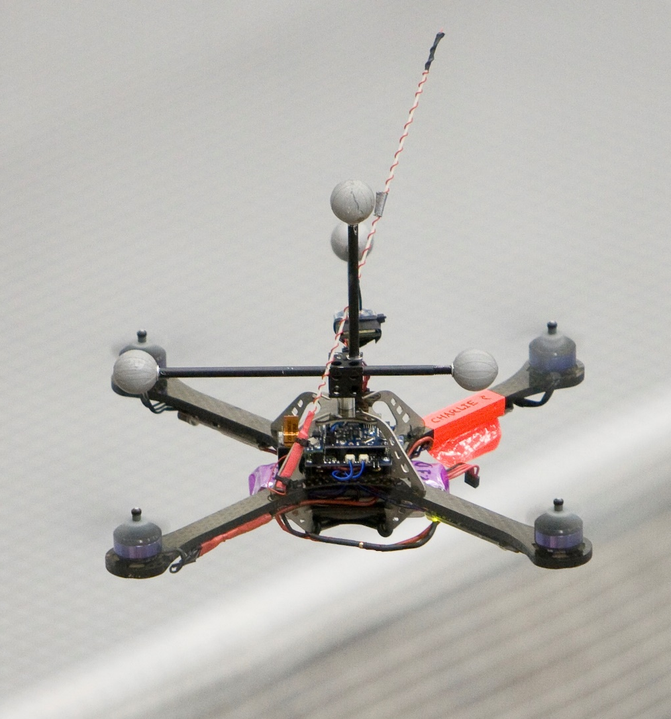
Why quadrotors?
Vertical take-off and landing
Mechanically simple
Highly maneuverable
Main characteristics:
Rigid frame
Four independently controlled motors
Move by changing the motor speeds

Slide 8
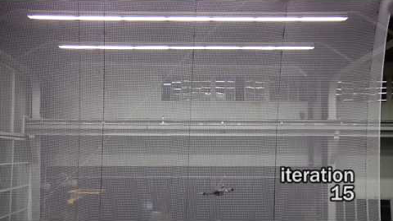
FLIP—up to 1800 degrees/second
youtu.be/bWExDW9J9sA

Slide 9
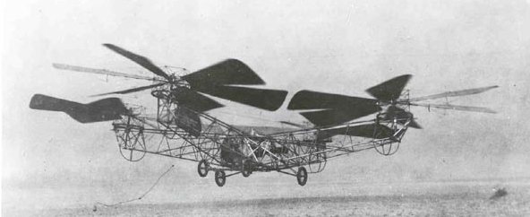
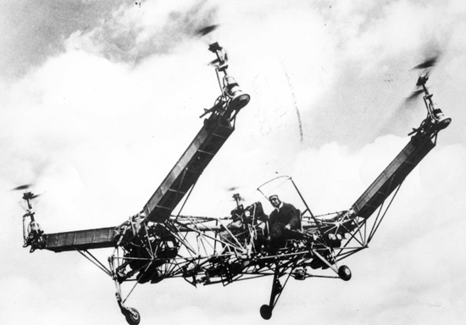
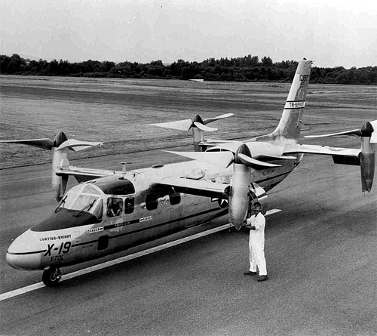
Quadrotor History
First successful flight in 1923
Design by George De Bothezat
Vertical take-off and landing (VTOL)
Poor stability, control
Later attempts
Used simple feedback control
De Bothezat Quadrotor (1923)
Convertawings Model "A" (1956)
Curtiss-Wright X-19A (1960)
Notes:
Highlight that controllers are needed for this!

Slide 10
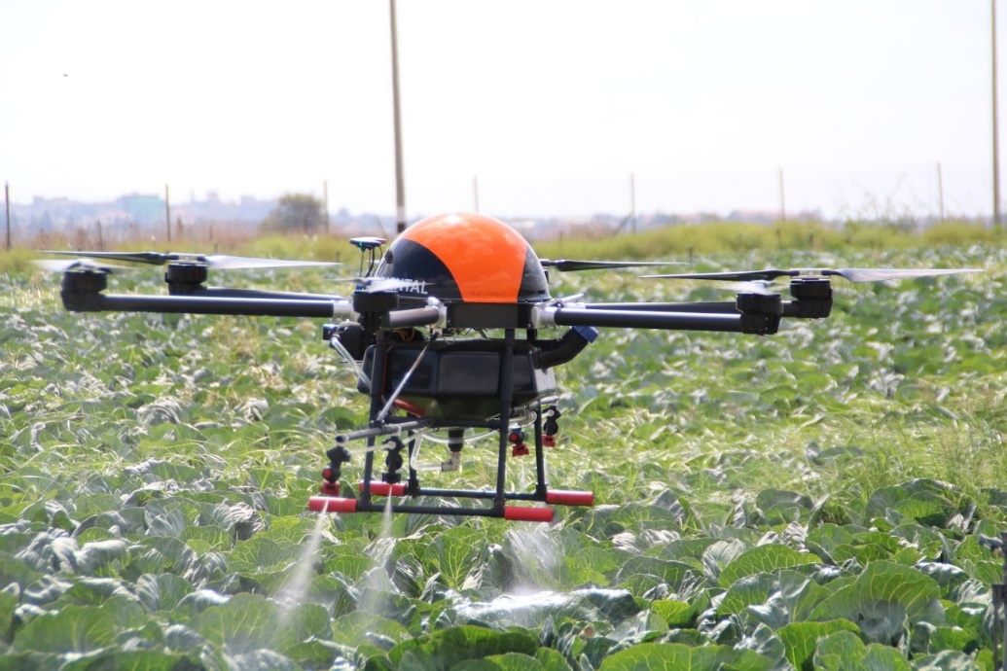
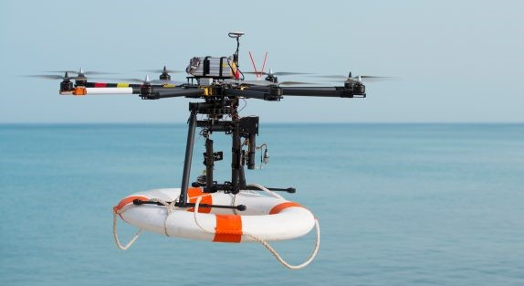
Why Quadrotors?
Wide range of applications:
Agriculture
Search and rescue
Filming
Entertainment
Archeology
Delivery
Passenger flight
Many others…

Slide 11

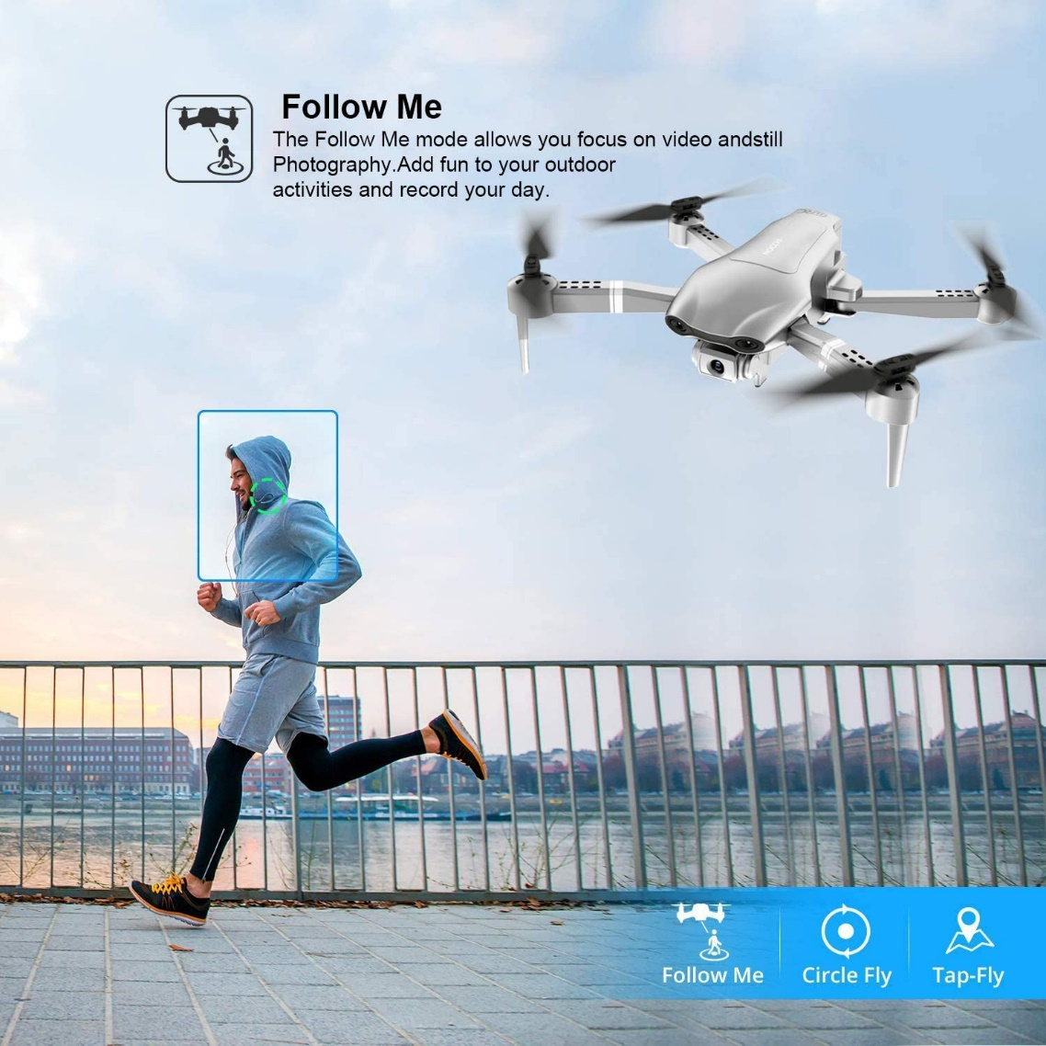
Why Quadrotors?
Wide range of applications:
Agriculture
Search and rescue
Filming
Entertainment
Archeology
Delivery
Passenger flight
Many others…

Slide 12
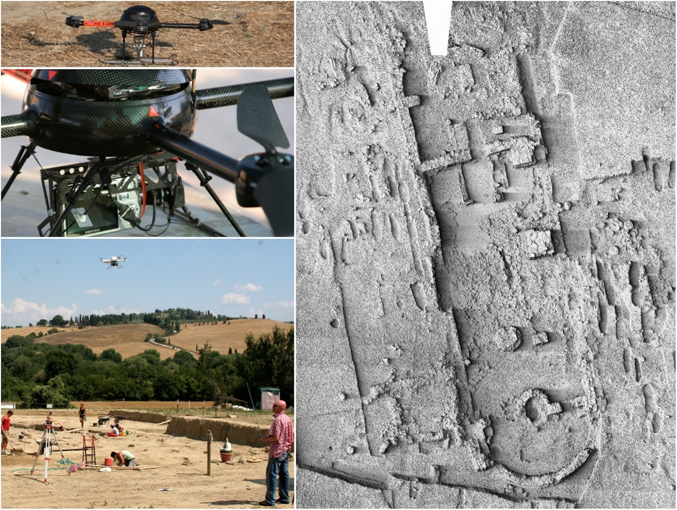
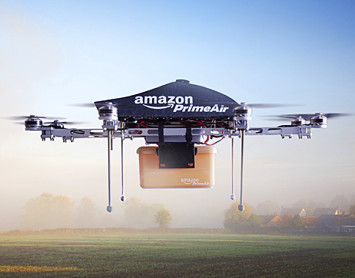
Why Quadrotors?
Wide range of applications:
Agriculture
Search and rescue
Filming
Entertainment
Archeology
Delivery
Passenger flight
Many others…

Slide 13
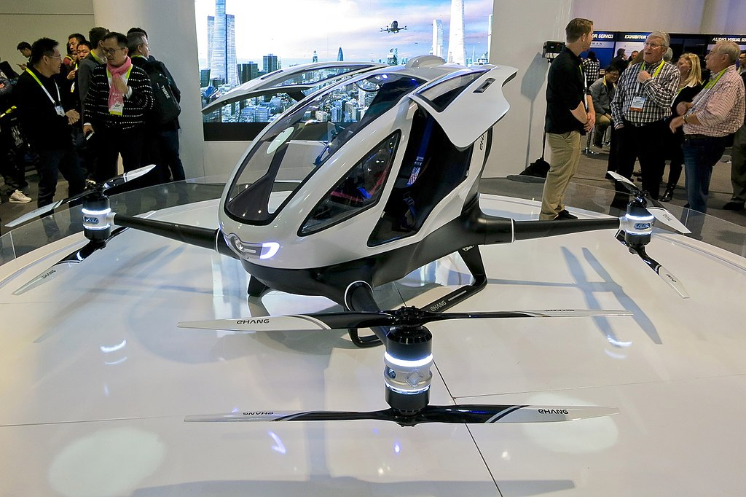
Why Quadrotors?
Wide range of applications:
Agriculture
Search and rescue
Filming
Entertainment
Archeology
Delivery
Passenger flight
Many others…

Slide 14
Quadrotor Dynamics and Control I
Motivation
Why quadrotors?
Why control?
How does a quadrotor move?
What is the quadrotor control architecture?
How to control a 1D quadrotor?
Simulator and initial control exploration

Slide 15
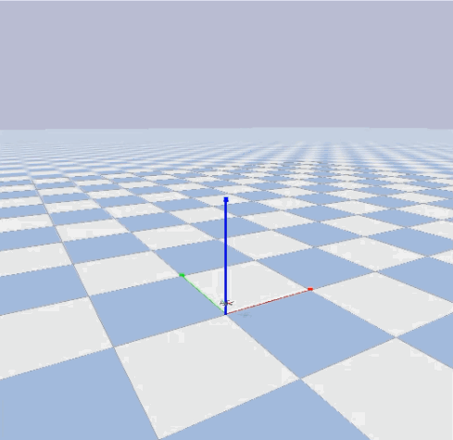
Why Control?
Enable self-regulating systems
Cope with disturbances
Enable stable and (potentially) autonomous flight!

Slide 16

Why Control?
Enable self-regulating systems
Cope with disturbances
Enable stable and (potentially) autonomous flight!

Slide 17
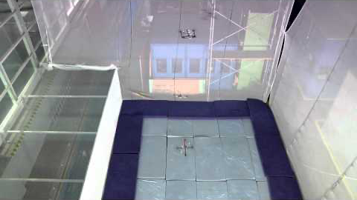
Armageddon
youtu.be/7r281vgfotg

Slide 18
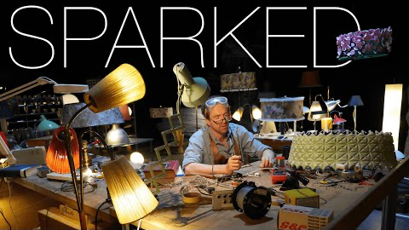
Sparked
youtu.be/6C8OJsHfmpI

Slide 19
Why is Control Relevant for Flying Robots?
To enable stable and (potentially) autonomous flight!

Slide 20
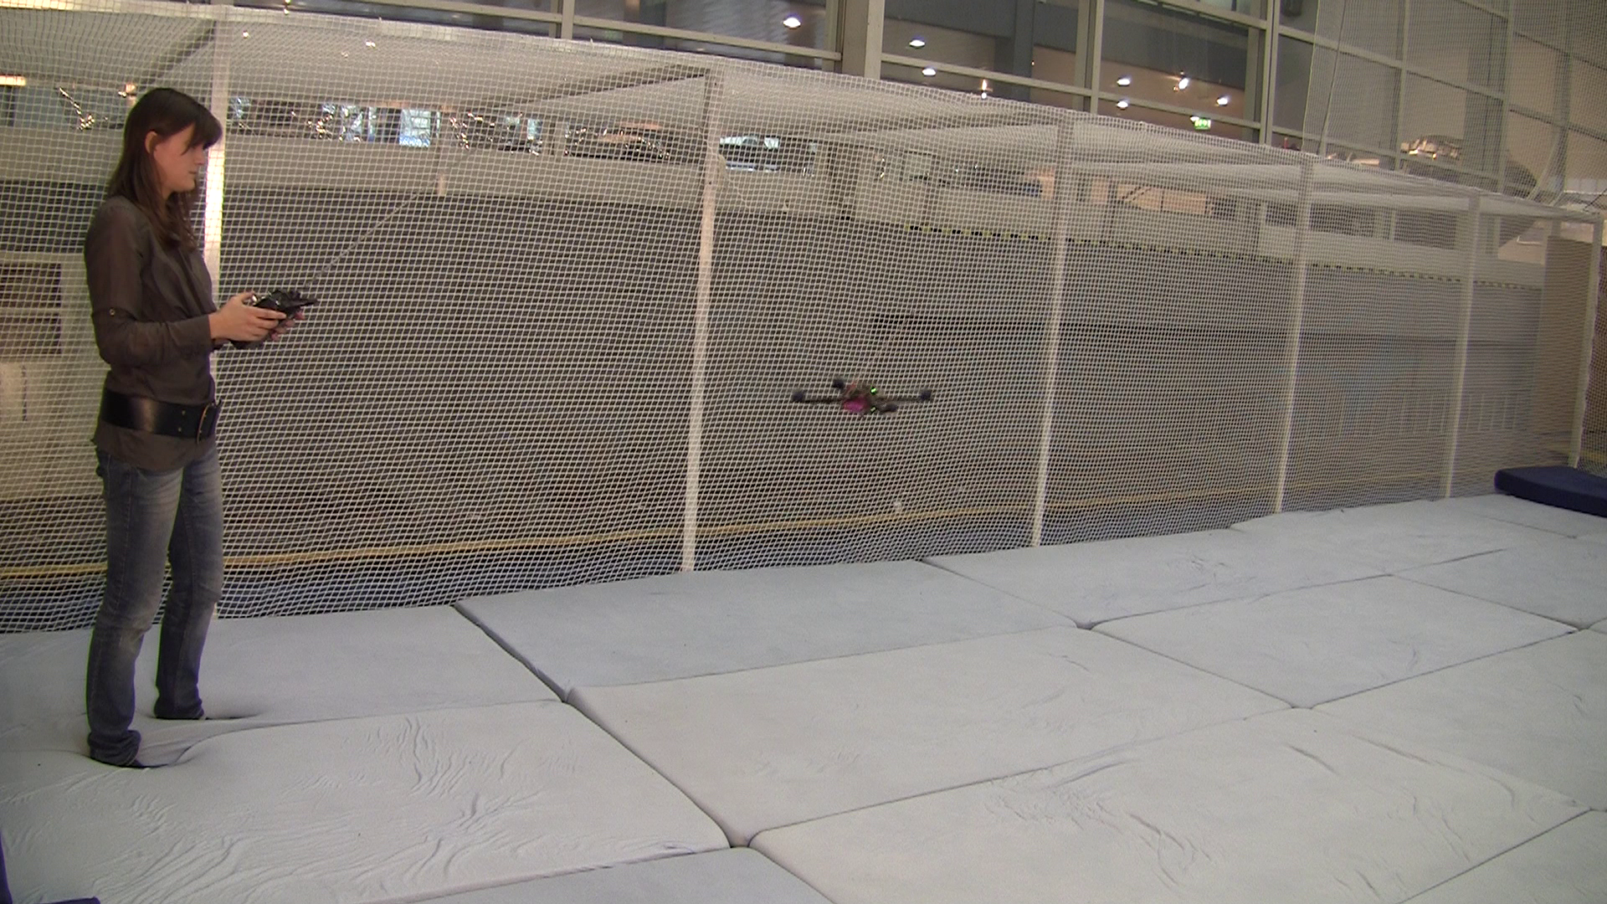
How Does Control Work?
COMPUTE
SENSE
ACT
REQUIRES understanding of quadrotor behavior

Slide 21
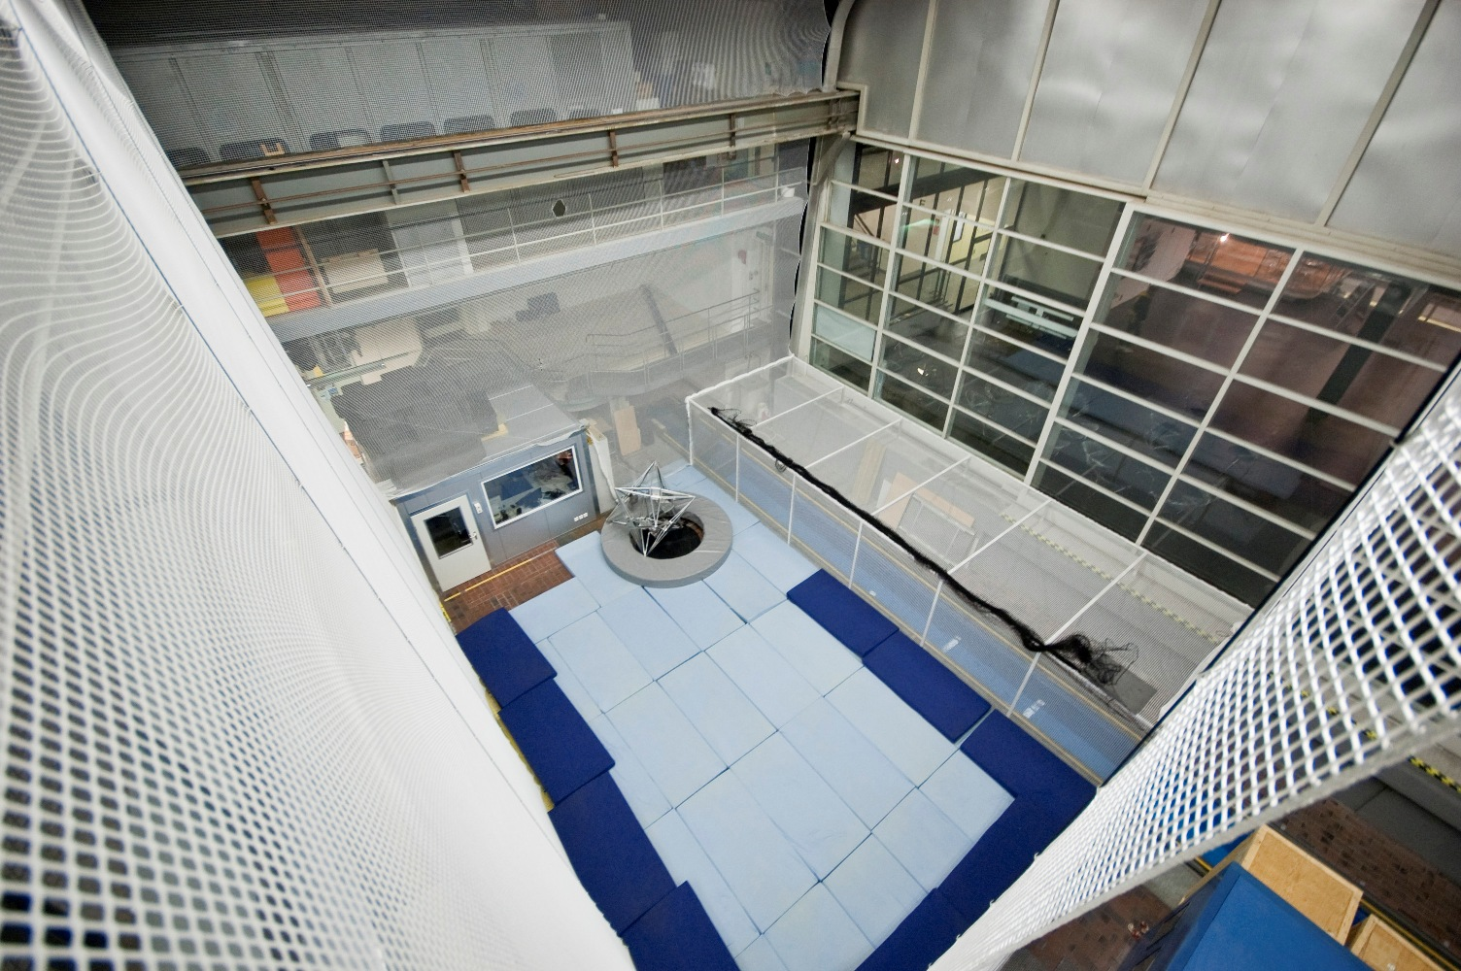
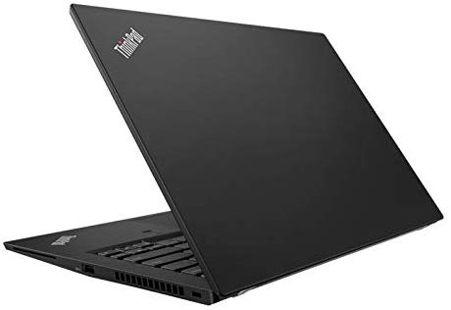
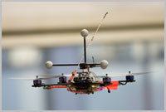
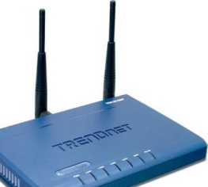
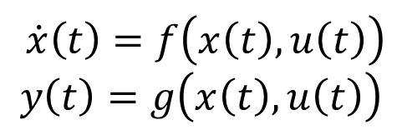
Automated Control
SENSE
COMPUTE
ACT
$$\dot{x}\left(t\right)=f\left(x\left(t\right),u\left(t\right)\right)$$
$$y\left(t\right)=g\left(x\left(t\right),u\left(t\right)\right)$$
REQUIRES mathematical model, physics

Slide 22
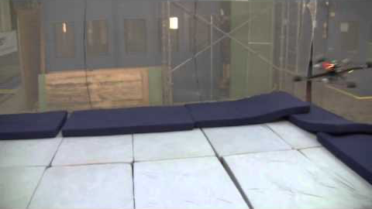
Dynamic Response
youtu.be/nQ2ziVW6kts

Slide 23
Quadrotor Dynamics and Control I
Motivation
How does a quadrotor move?
Motor force and moment
Quadrotor movements
What is the quadrotor control architecture?
How to control a 1D quadrotor?
Simulator and initial control exploration

Slide 24
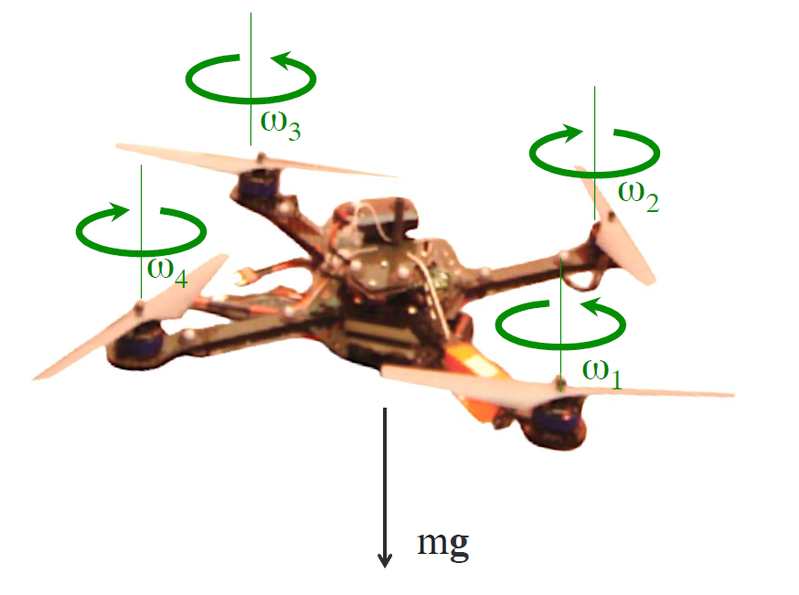
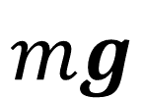
Basic Mechanics
$$mg$$
Powers C., Mellinger D., Kumar V. (2015) Quadrotor Kinematics and Dynamics. In: Valavanis K., Vachtsevanos G. (eds) Handbook of Unmanned Aerial Vehicles. Springer, Dordrecht

Slide 25
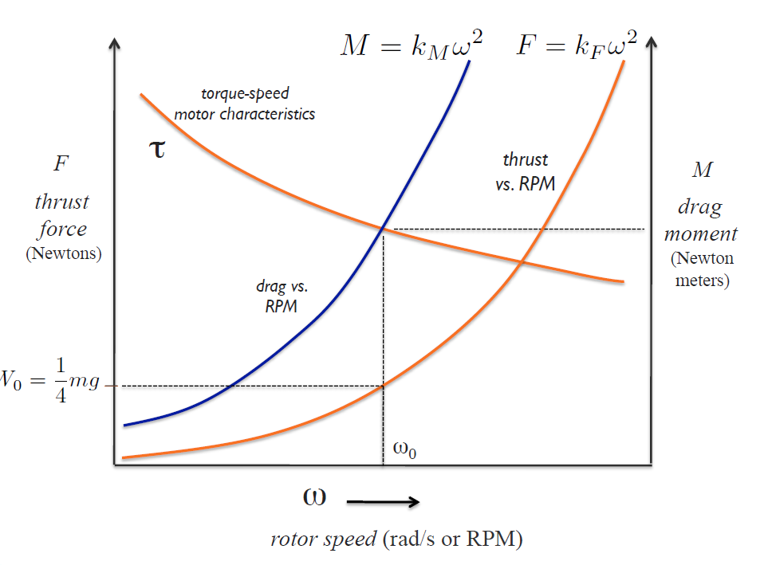
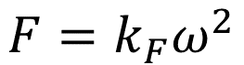
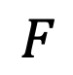
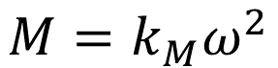
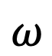
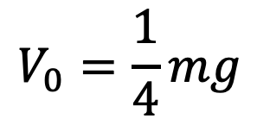
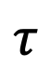
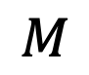
Basic Mechanics: Rotor Physics
Rotors produce Force and Moment
$$M=k_{M}ω^{2}$$
$$F=k_{F}ω^{2}$$
$$F$$
$$τ$$
$$M$$
$$V_{0}=\frac{1}{4}mg$$
$$ω$$

Slide 26
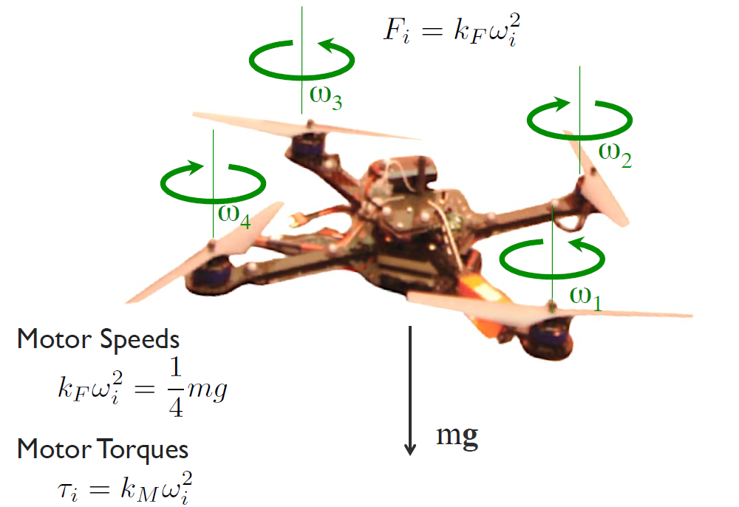
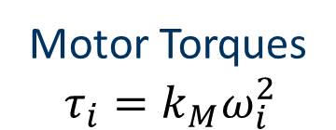
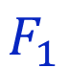
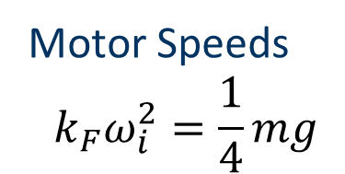
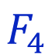
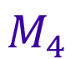
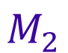
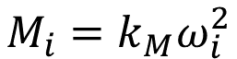
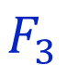
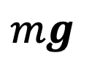
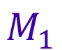
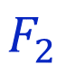
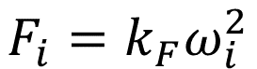
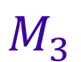
Basic Mechanics: Hover
$$F_{3}$$
$$F_{2}$$
$$M_{3}$$
Motor Speeds
$$k_{F}ω_{i}^{2}=\frac{1}{4}mg$$
$$F_{4}$$
$$M_{2}$$
$$F_{i}=k_{F}ω_{i}^{2}$$
$$M_{4}$$
$$F_{1}$$
$$M_{1}$$
Motor Torques
$$τ_{i}=k_{M}ω_{i}^{2}$$
$$M_{i}=k_{M}ω_{i}^{2}$$
$$mg$$

Slide 27














Basic Mechanics: Hover
$$F_{3}$$
$$F_{i}=k_{F}ω_{i}^{2}$$
$$F_{2}$$
$$M_{3}$$
$$M_{i}=k_{M}ω_{i}^{2}$$
$$F_{4}$$
$$M_{2}$$
$$M_{4}$$
$$r_{3}$$
$$b_{3}$$
$$F_{1}$$
$$b_{2}$$
$$r_{2}$$
$$a_{3}$$
$$M_{1}$$
$$r_{4}$$
$$b_{1}$$
$$a_{2}$$
$$r_{1}$$
$$a_{1}$$
Resultant Force
$$F=F_{1}+F_{2}+F_{3}+F_{4}−mga_{3}$$
Resultant Moment
$M=r_{1}×F_{1}+r_{2}×F_{2}+r_{3}×F_{3}+r_{4}×F_{4}+M_{1}+M_{2}$ $+M_{3}$ $+M_{4}$
$$mg$$

Slide 28
Quadrotor Dynamics and Control I
Motivation
How does a quadrotor move?
Motor force and moment
Quadrotor movements
What is the quadrotor control architecture?
How to control a 1D quadrotor?
Simulator and initial control exploration

Slide 29





How to Actuate the Quadrotor?
Vary the speeds of the rotors to control the position and orientation of the quadrotor

Slide 30

Roll and Pitch
Green arrows represent the force produced by the motor, which is roughly proportional to the squared rotor speed

Slide 31
Roll and Pitch

Slide 32
Roll and Pitch

Slide 33
Roll and Pitch

Slide 34
Translation

Slide 35

Yaw
How do you get the robot to steer/yaw?
Increase or decrease the speed of $ω_{1}$and $ω_{3}$ OR $ω_{2}$and $ω_{4}$

Slide 36

youtu.be/NPvGxIBt3Hs
Dance

Slide 37

Question
The robot has 6 degrees of freedom!
How many different ways can you rotate or translate the robot?
How many of them are independent given that the robot has 4 motors?

Slide 38
Quadrotor Dynamics and Control I
Motivation
How does a quadrotor move?
What is the quadrotor control architecture?
How to control a 1D quadrotor?
Simulator and initial control exploration

Slide 39
Nested Control Architecture
Mid-level objective 1
Mid-level objective n
Mid-level objective n+1
Low-level objective
High-level objective
High-Level Task
…
Mid-Level Task
…
Low-Level Task
Plant Input
Measured features
Measured features
Measured features
Enables a systematic translation of a high-level objective into a plant input
Notes:
Autonomous car. Go somewhere, waypoints, velocity commands, acceleration commands, opening of gas valves

Slide 40

Nested Control Architecture
Motion
Cost
Function
Position
+ Yaw
Angles + Thrust
Body Turn Rate + Thrust
Motor Turn Rates
High-Level Task
High-level Objective
Position Ctrl
Angle Ctrl
Rate Ctrl
Motor Ctrl
Position + Yaw
Angle Meas./ Estimates
Gyroscopes (+Accelerometer)
Features
Measured Turn Rates
Control allows us to focus on the high-level task

Slide 41
Q&A
Break

Slide 42
Quadrotor Dynamics and Control I
Motivation
How does a quadrotor move?
What is the quadrotor control architecture?
How to control a 1D quadrotor?
1D quadrotor equations of motion
Designing a PD controller
PD applied to 1D quadrotor
Simulator and initial control exploration

Slide 43



Dynamics in the Vertical Direction
Hover:
$$\sum_{i=1}^{4}{k_{F}ω_{i}^{2}}−mg=0$$
Move:
$$\sum_{i=1}^{4}{k_{F}ω_{i}^{2}}−mg=ma$$

Slide 44
Quadrotor Dynamics and Control I
Motivation
How does a quadrotor move?
What is the quadrotor control architecture?
How to control a 1D quadrotor?
1D quadrotor equations of motion
Designing a PD controller
PD applied to 1D quadrotor
Simulator and initial control exploration

Slide 45

Designing a PD Controller
Problem statement
Given a system of the following form
$$\ddot{x}(t)=u(t)$$
where $x∈ℝ$ is the state, and $u∈ℝ$ is the input, design a controller such that $x(t)$follows the desired trajectory $x^{des}(t)$.
Define error: $e\left(t\right)=x^{des}\left(t\right)−x(t)$
Define control objective: “Make $e\left(t\right)$ exponentially converge to 0.”
Choose an appropriate controller.
Plant model

Slide 46





Designing a PD Controller
Find $u$such that the error converges exponentially to 0.
$\ddot{e}(t)+K_{v}\dot{e}(t)+K_{p}e(t)=0$ $K_{p}, K_{v}>0$
$${\ddot{x}}^{des}\left(t\right)−\ddot{x}(t)+K_{v}\dot{e}(t)+K_{p}e(t)=0$$
Second-order system response
$$\ddot{e}\left(t\right)={\ddot{x}}^{des}\left(t\right)−\ddot{x}(t)$$
$$\ddot{x}\left(t\right)=u(t)$$
$$u\left(t\right)={\ddot{x}}^{des}(t)+K_{v}\dot{e}(t)+K_{p}e(t)$$
PD controller error step response
Feedforward Derivative Proportional

Slide 47

PD and PID Control Overview
PD Control
$$u\left(t\right)={\ddot{x}}^{des}(t)+K_{v}\dot{e}(t)+K_{p}e(t)$$
Proportional control acts like a spring (capacitance) response.
Derivative control is a viscous dashpot (resistance) response.
Large derivative gain makes the system overdamped (slow convergence).
PID Control
Often advantageous with disturbances (e.g. wind) or modeling errors (e.g. unknown mass).
$$u\left(t\right)={\ddot{x}}^{des}\left(t\right)+K_{v}\dot{e}\left(t\right)+K_{p}e\left(t\right)+K_{i}\int_{0}^{t}{e\left(τ\right)dτ}$$
Integral control makes the steady-state error go to zero.
PID control generates a third-order closed-loop system.
Steady-state error may be different from zero
Integral
Integral part could cause unwanted effects, such as windup

Slide 48





Effect of Different PD Gains
Stable
Marginally Stable
Unstable
$$K_{p}, K_{v}>0$$
$$K_{p}>0, K_{v}=0$$
$K_{p} o$r $K_{v}<0$
How to design $K_{p}, K_{v}$ ?

Slide 49


Alternative Parameterization
$\ddot{x}(t)=u(t)$, $u\left(t\right)≔K_{p}(x^{des}(t)−x(t))+K_{v}({\dot{x}}^{des}(t)−\dot{x}(t))+{\ddot{x}}^{des}(t)$
⟹ $\ddot{e}(t)+K_{v}\dot{e}(t)+K_{p}e(t)=0$
⟹ $\ddot{e}(t)+2ζω_{n}\dot{e}(t)+ω_{n}^{2}e(t)=0$
Feedforward term
Intuitive parameterization:
Damping ratio: $ζ∈[0.7..1]$
Natural frequency, related to rise time (10-90%): $ω_{n}≈\frac{t_{r}}{1.8}$
Settling time: $t_{s}≈\frac{4.6}{ζω_{n}}$

Slide 50





Second-Order System Characteristics
Definition of rise time t_{r}, peak time t_{p}, settling time t_{s}, and overshoot M_{p}:
$$t_{p}$$
$$M_{p}$$
$$t_{r}$$
$$t_{s}$$

Slide 51



Second-Order System Characteristics
Overshoot versus damping ratio for the second-order system:
$$M_{p} \left(\%\right)$$
$$ζ$$

Slide 52




Second-Order System Characteristics
Step responses of second-order systems versus ζ
$$ζ=0$$
$$y(t)$$
$$ω_{n}t$$

Slide 53
Quadrotor Dynamics and Control I
Motivation
How does a quadrotor move?
What is the quadrotor control architecture?
How to control a 1D quadrotor?
1D quadrotor equations of motion
Designing a PD controller
PD applied to 1D quadrotor
Simulator and initial control exploration

Slide 54





Control in the Vertical Direction
$$\text{vertical}$$
$$\text{displacement}$$
$$x$$
actual system input
$$\sum_{i=1}^{4}{k_{F}ω_{i}^{2}(t)}−mg=ma(t)=m\ddot{x}(t)→a(t)=\frac{d^{2}x\left(t\right)}{dt^{2}}=\ddot{x}(t)$$
$$Equation of motion:$$
state
$$Nonlinear relationship between state and input$$
$$For vertical direction only, all ω_{i} are the equal$$

Slide 55







Control in the Vertical Direction
$$\text{vertical}$$
$$\text{displacement}$$
$$x$$
$$\sum_{i=1}^{4}{k_{F}ω_{i}^{2}(t)}−mg=m\ddot{x}(t)$$
Equations of motion:
$$u(t)=\frac{1}{m}\left[\sum_{i=1}^{4}{k_{F}ω_{i}^{2}}(t)−mg\right]$$
$$\text{Define} \text{the} \text{control} \text{input} \text{as}\text{:}$$
$$\text{to} \text{obtain} \text{the} \text{se}\text{cond}\text{-}\text{order} \text{system}$$
We have defined a PD controller
for this system!
$$\ddot{x}(t)=u(t)$$
$$u\left(t\right)={\ddot{x}}^{des}(t)+K_{v}\dot{e}(t)+K_{p}e(t)$$
Feedforward Derivative Proportional

Slide 56
Q&A
Break

Slide 57
Quadrotor Dynamics and Control I
Motivation
Quadrotors require controllers to work well
How does a quadrotor move?
Varying motor speeds
What is the quadrotor control architecture?
Nested control architecture
How to control a 1D quadrotor?
PD controller for a 1D quadrotor
Simulator and initial control exploration

Slide 58
Downloading and Installing the Simulator
Instructions in the following link: https://github.com/JacopoPan/gym-pybullet-drones/blob/master/assignments/README.md

Slide 59
How does the simulator work?
Environment: contains parameters and methods
To simulate the quadrotors, e.g., mass and inertia of the quadrotor, gravity, equations of motion of the quadrotor, etc.
To simulate obstacles, e.g., size, location, etc.
To simulate aerodynamic effects, e.g. drag, ground effect, etc.
To estimate the pose of the quadrotor [ground truth].
Controller: contains the parameters and methods to calculate the required motor turn rates for the quadrotor to achieve a desired task.
We will design this component!

Slide 60




Transferring our PD controller to the simulator
$$u(t)=\frac{1}{m}\left[\sum_{i=1}^{4}{k_{F}ω_{i}^{2}(t)}−mg\right]$$
Overcome nonlinearity of model
We defined the control input :
We compute the PD control input:
Solve for the motor turn rates:
To restrict movement to the $z$ direction, all motor turn rates are equal.
Controller inputs:
Controller outputs:
$$u_{ctrl}\left(t\right)={\ddot{x}}^{des}(t)+K_{v}\dot{e}(t)+K_{p}e(t)$$
$$ω_{i}\left(t\right)=\sqrt{\frac{mu_{ctrl}\left(t\right)+mg}{4k_{F}}}$$
Desired acceleration and desired and measured position and velocity
Four motor turn rate commands

Slide 61
Quadrotor Dynamics and Control I
Motivation
Quadrotors require controllers to work well
How does a quadrotor move?
Varying motor speeds
What is the quadrotor control architecture?
Nested control architecture
How to control a 1D quadrotor?
PD controller for a 1D quadrotor
Simulator and initial control exploration

